Slide 1
Troubleshooting

Slide 2
Agenda
JVM settings and Garbage Collection
Identifying JVM Issues with Heap Dumps
Identifying Application or Script Issues with Thread Dumps

Slide 3
JVM Configuration Options and Recommendations
-server
Use server JVM and not client JVM
ALWAYS set this on application servers if not automatically enabled
-Xms
Starting heap size
-Xmx
Maximum heap size
-XX:NewSize & -XX:MaxNewSize
Size for the “eden” or young generation part of the heap
Should generally be ¼ of the size of the total heap
-XX:MaxPermSize
Maximum size of the Permanent Generation space, which holds information about the class and method objects loaded in the JVM
Size is in addition to the heap allocation!

Slide 4
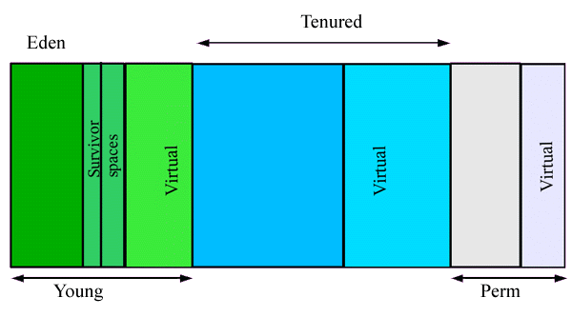
Quick Overview of Garbage Collection
Minor GC moves objects from Eden to the Survivor Spaces in the Young Generation space, and from the Survivor Space to the Tenured area in the Old Generation if they remain alive long enough
A Full GC occurs when the Tenured area fills up
The PermGen space holds all of the classes and methods
-XX:+UseConcMarkSweepGC (<=4 cores) or -XX:+UseParallelOldGC (>4 cores)
JVM flags are different between vendors!
i.e. gcpolicy for IBM

Slide 5
Monitoring Garbage Collection
-verbose:gc
Optional settings:
-Xloggc:/<path>/gc.log
-XX:+PrintGCDetails
-XX:+PrintGCTimeStamps

Slide 6
Garbage Collection Details
7.352: [GC [PSYoungGen: 147456K->7794K(172032K)] 147456K->7794K(1024000K), 0.0289447 secs]
11.031: [GC [PSYoungGen: 155250K->10557K(172032K)] 155250K->10557K(1024000K), 0.0422060 secs]
14.815: [GC [PSYoungGen: 158013K->13580K(172032K)] 158013K->13580K(1024000K), 0.0527533 secs]
20.893: [GC [PSYoungGen: 161036K->16261K(172032K)] 161036K->16261K(1024000K), 0.0796482 secs]
24.566: [GC [PSYoungGen: 163717K->19239K(172032K)] 163717K->19239K(1024000K), 0.0666056 secs]
27.926: [GC [PSYoungGen: 166695K->21560K(168128K)] 166695K->21560K(1020096K), 0.0741122 secs]
31.429: [GC [PSYoungGen: 167608K->15863K(171328K)] 167608K->25747K(1023296K), 0.0843131 secs]
33.920: [GC [PSYoungGen: 161911K->11698K(172736K)] 171795K->27042K(1024704K), 0.0520438 secs]
35.753: [GC [PSYoungGen: 72365K->9351K(172288K)] 87709K->30267K(1024256K), 0.0483402 secs]
35.801: [Full GC (System) [PSYoungGen: 9351K->0K(172288K)] [ParOldGen: 20915K->29752K(851968K)] 30267K->29752K(1024256K) [PSPermGen: 77251K->77150K(154624K)], 0.7119282 secs]
41.109: [GC [PSYoungGen: 148408K->7162K(172544K)] 178161K->36914K(1024512K), 0.0246259 secs]
Minor collection
Full garbage collection
35.801 seconds after startup:
Young generation reduced from 9315K to 0K
Old generation reduced from 29752K to 20915K
Complete heap usage reduced from 30267K to 29752K (out of a max of 1024256K)
Time taken: 0.7119282 seconds

Slide 7
Identifying a Memory Leak
Each Full GC releases less and less memory
Begin Steady State

Slide 8
Different Types of OutOfMemory Errors
java.lang.OutOfMemoryError: PermGen space
The number and size of methods and classes needed in PermGen does not fit
Increase the MaxPermSize setting if unable to allocate permgen space
java.lang.OutOfMemoryError: Java heap space
Heap is full and Full GC cannot reclaim enough space to continue
May be due to memory shortage or memory leak
Get a heap dump and analyze to discover where the memory is being consumed
java.lang.OutOfMemoryError: unable to create new native thread
The java process has reached some kind of OS-defined limit
Process size
Open sockets

Slide 9
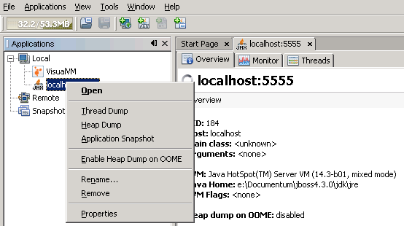
Creating Heap Dumps
Heap dumps help identify memory leaks or excessive consumption
Heap dumps can be collected on demand or when OOM occurs:
-XX+HeapDumpOnOutOfMemoryError
Automatically generate heap dumps when an OOM is encountered
Application will “freeze” while the dump is being performed
Multiple heap dumps may be created over time
-XX+HeapDumpOnCtrlBreak
Force the creation of a heap dump with “Ctrl-Break” on Windows (if not running as a service) or “kill -3 PID” on Unix
jvisualvm can be used to create a dump
jmap can be used if the app server is not started as a service:
C:\> jmap -dump:format=b,file=heap.bin 7024
Dumping heap to C:\Documents and Settings\Administrator\heap.bin ...
Heap dump file created

Slide 10
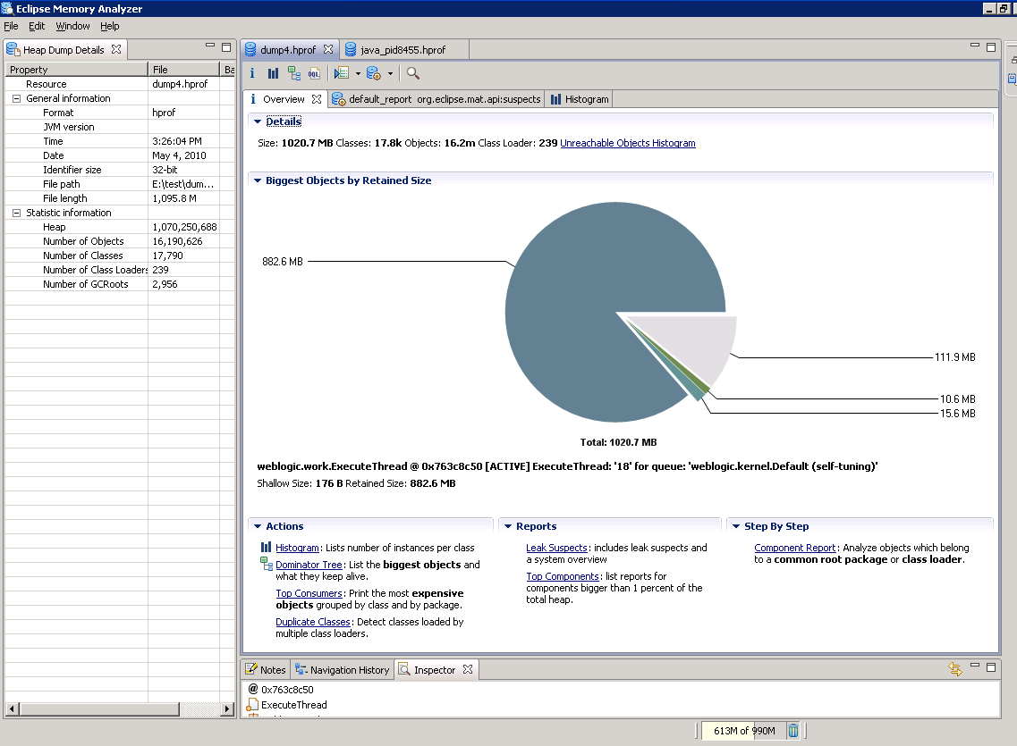
Heap Analysis with the Eclipse Memory Analyzer
Open source heap analyzer
Heap dumps from all OS can be parsed
plugin required for IBM heap dumps
Up to 2GB dump can be parsed on 32-bit OS

Slide 11
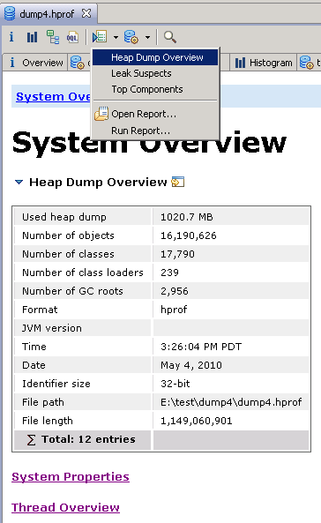
Heap Dump Overview Report
Shows java settings
Shows thread details (state, retained size)

Slide 12
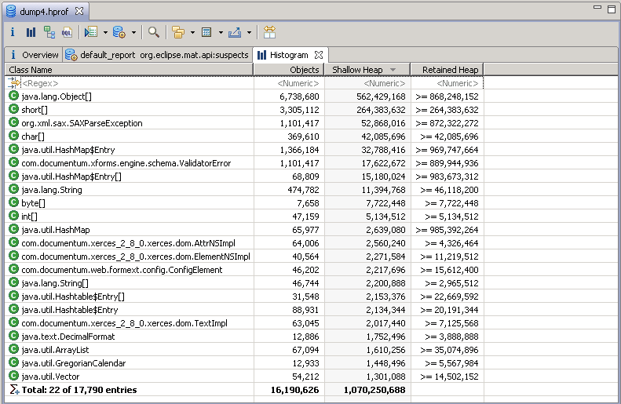
Default Histogram – By Class
Shallow Heap is the memory consumed by one object
Retained heap is the sum of all shallow heaps kept alive by that object

Slide 13
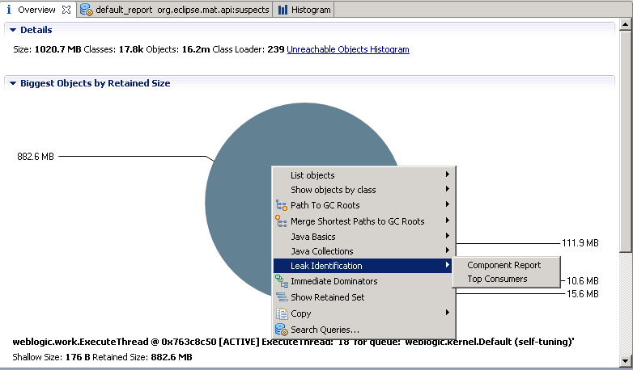
Overview Report

Slide 14
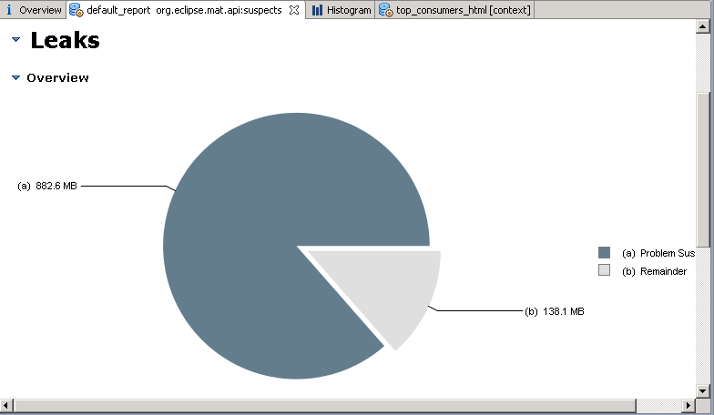
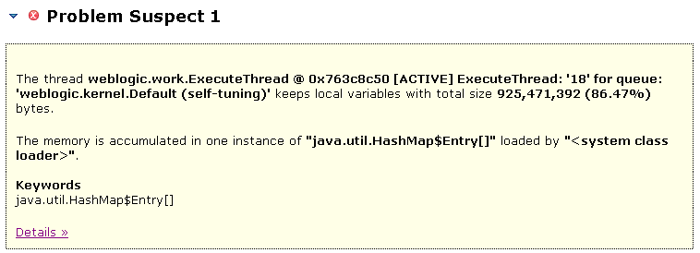
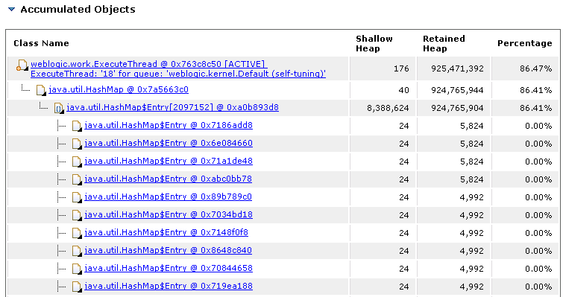
Leak Suspect Report

Slide 15
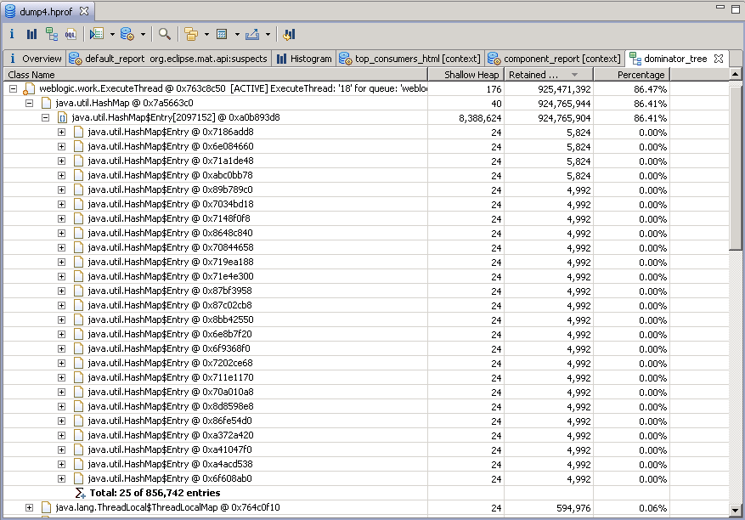
Dominator Tree – Locate Large Drop
856,742 hash map entries are consuming 86% of the heap!

Slide 16
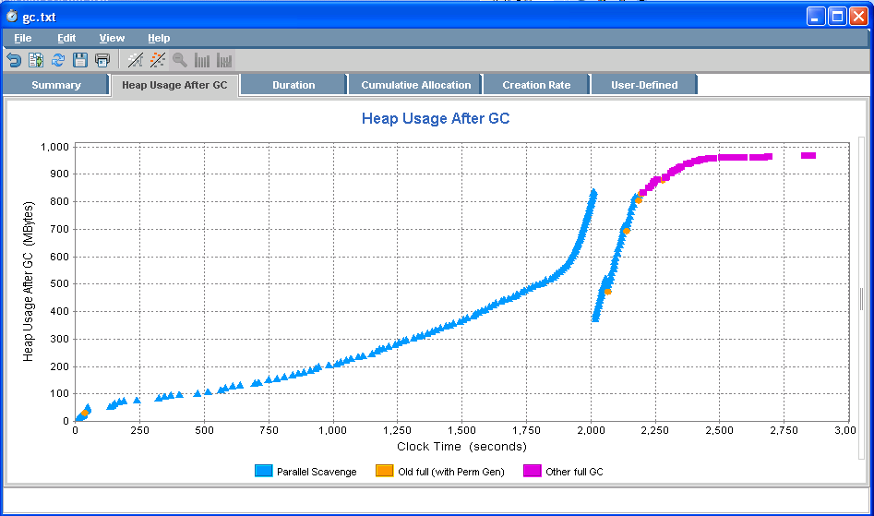
Garbage Collection Analysis (Using HPjmeter)
Completely out of memory in under an hour!

Slide 17
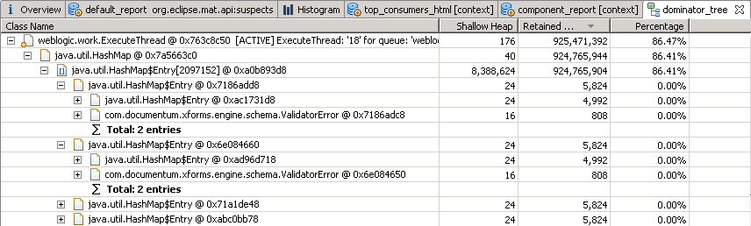
Dominator Tree
This heap dump was taken during load testing at a customer site
The Schema Validator was not thread-safe and caused huge numbers of errors to be generated, rapidly filling up the heap

Slide 18
Summary – JVM Memory Analysis
Instrument the JVM to dump the heap to a file automatically on OOM
Look at Heap Histogram to identify classes with high shallow and retained heap sizes
Look at the Leak Suspects report to jump to objects holding on to a lot of heap
Look a the Dominator Tree to look for large drops in Retained Size
Try to identify the source of the leak by tracing back to the GC Roots

Slide 19
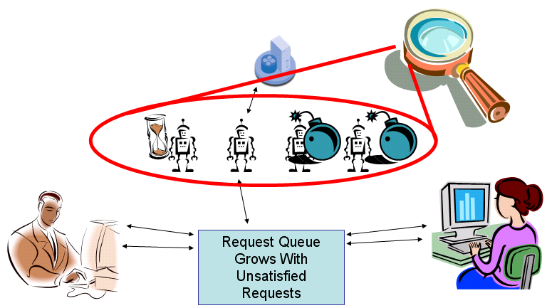
Monitoring and Diagnosing Thread Issues
JVM is still up and running and JVM has plenty of available heap, BUT…
Application will appear to “hang” and no requests will be processed
Generally caused by “stuck threads”
threads in some sort of wait condition that never get released

Slide 20
Obtaining a Thread Dump
Java will dump information about the threads and their status when it receives the SIGQUIT signal (kill -3)
Most administration tools provide the ability to generate a thread dump
Java tools like “jvisualvm” and “jstack” can also generate thread dumps
May need to start the JVM with additional options to connect
-Dcom.sun.management.jmxremote.authenticate=false
-Dcom.sun.management.jmxremote.ssl=false
-Dcom.sun.management.jmxremote.port=portNum
(** not recommended for production)

Slide 21
What do Thread Dumps Report?
Each thread in the pool will report:
Thread status:
Running or runnable
Suspended
Waiting on some condition
Waiting on a monitor lock
Thread stack:
What command it is executing at the time of the dump
Some actions can be expected to take a long time, others should not and require further investigation

Slide 22
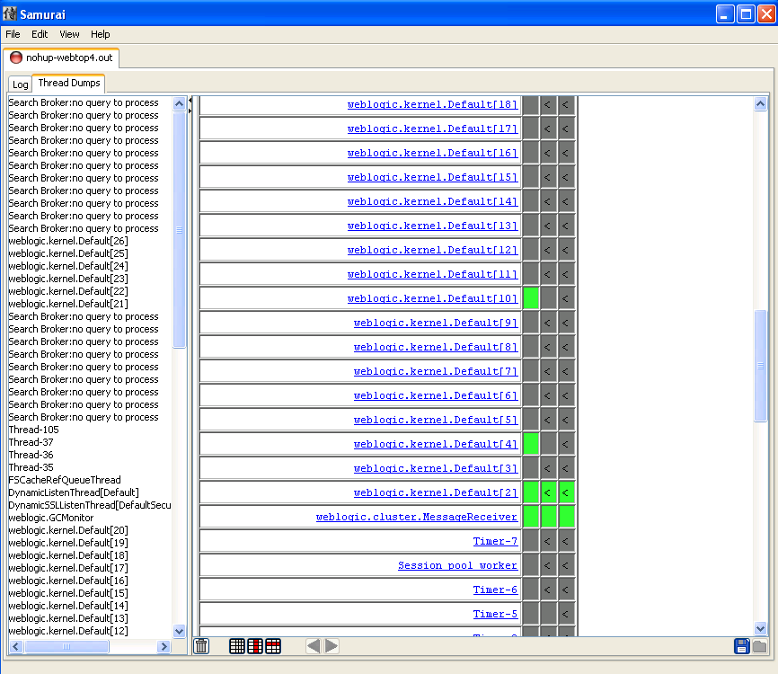
Thread Dump Collection and Analysis - Samurai
If stuck threads are being reported it is useful to get 3+ thread dumps 5 to 10 minutes apart
Samurai can analyze those thread dumps and show whether the threads truly are stuck or simply executing the same task as the last dump

Slide 23
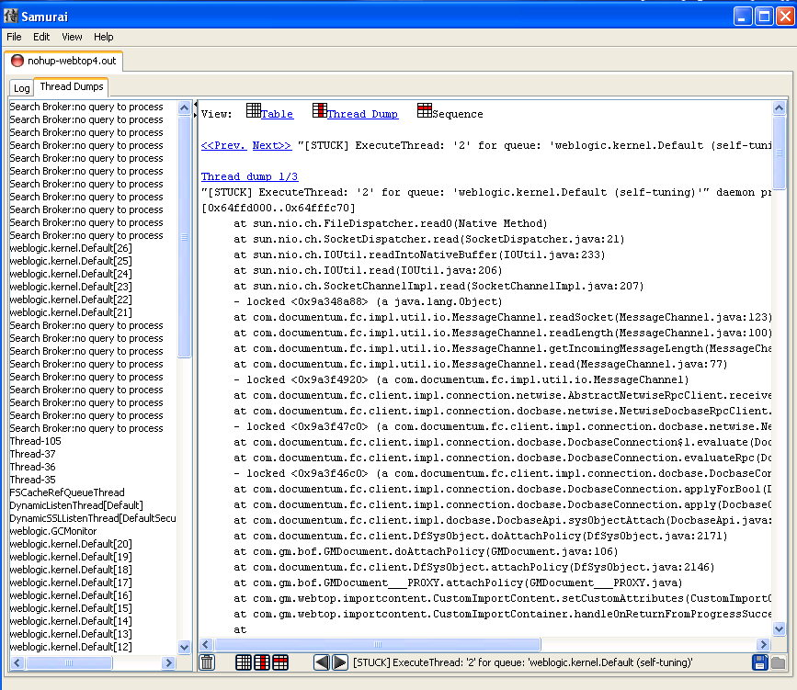
Samurai – Thread Detail
Threads will report which objects they are waiting on
Search the thread dump to see who holds that lock
Some UCF transfers may appear to be stuck, but in reality transfer is taking a long time (BOCS/ACS)

Slide 24

Q&A

